Slide 1

Capstone Project Phase B Choosing Best Fit Framework For Web Application “EVolve”
Daniel Moshe Ben David Idan Daar
Supervisor: Mr. Alexander Keselman
Project Number: 23-2-D-1

Slide 2
Presentation content
01
02
03
04
Background
Solution
Product
Introduction about the difficulty of choosing framework
Our solution to the problem
Software architecture and documents
05
06
Verification
Demonstration
Challenges &
Conclusions
With performance and functionality testing
In action
Implementation challenges and conclusions

Slide 3
01
Background
Introduction about the difficulty of choosing framework

Slide 4
Background
Now days choosing best fit framework for a web application is not an easy task:
10,000 - 15,000 frameworks that currently exist today.
Ensuring compatibility with existing systems is a critical factor.
Performance is a key metric in web applications.
With the rising threats in cyberspace, the security posture of a framework is of utmost importance.
The strength of a framework often lies in its community.

Slide 5
02
Solution Our solution to the problem

Slide 6
Solution
Evolve is a web application that offers electric vehicle owners a convenient way to locate the nearest available charging station.
We developed the same application “EVolve” twice, with two different frameworks combinations.
We performed the same performance testing on the application in its two variations.

Slide 7
React
React is a popular JavaScript library that simplifies the process of building interactive user interfaces for web applications. It's a core component of modern web development, allowing developers to create dynamic and responsive UIs efficiently.

Slide 8
Preact
Preact serves as a streamlined alternative to React, offering a similar component-based approach but with a smaller footprint. Preact enables developers to create responsive and dynamic web interfaces with a strong focus on minimizing overhead and optimizing performance.

Slide 9
Bootstrap
Bootstrap is a component-based framework and follows an object-oriented CSS approach. This framework includes a collection of pre-built components that can be utilized to rapidly design standard websites. Bootstrap requires four primary files to be integrated into the project, occupying approximately 300kb of space.

Slide 10
Tailwind
Unlike other frameworks, Tailwind CSS does not offer pre-made components for design purposes. Instead, users can create their own custom components using utility classes. Tailwind CSS only requires a style sheet, which consumes around 30kb of space.

Slide 11
Mapbox & Open Charge Map APIs
Mapbox API is a powerful tool for creating custom maps and location-based services. It's a key part of Mapbox's platform, enabling developers to integrate interactive maps into apps and websites.
Open Charge Map API is a vital resource for developers looking to access information about electric vehicle charging stations. This API is part of the Open Charge Map platform and enables seamless integration of EV charging data into applications and services.

Slide 12
03
Product Software architecture and documents

Slide 13
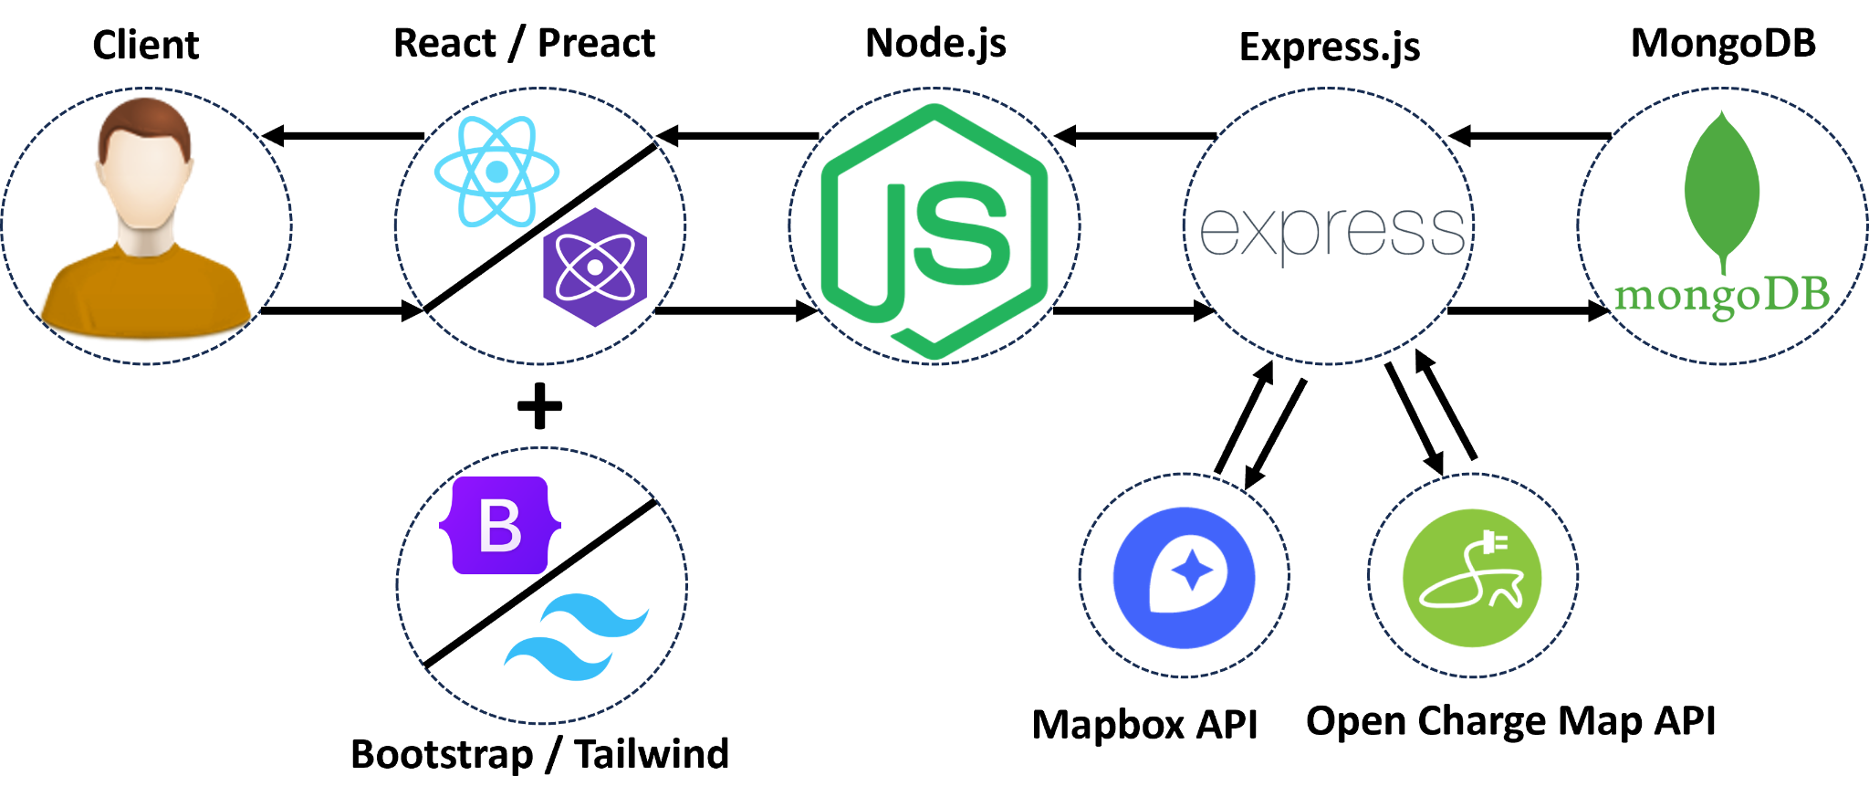
System’s architecture

Slide 14
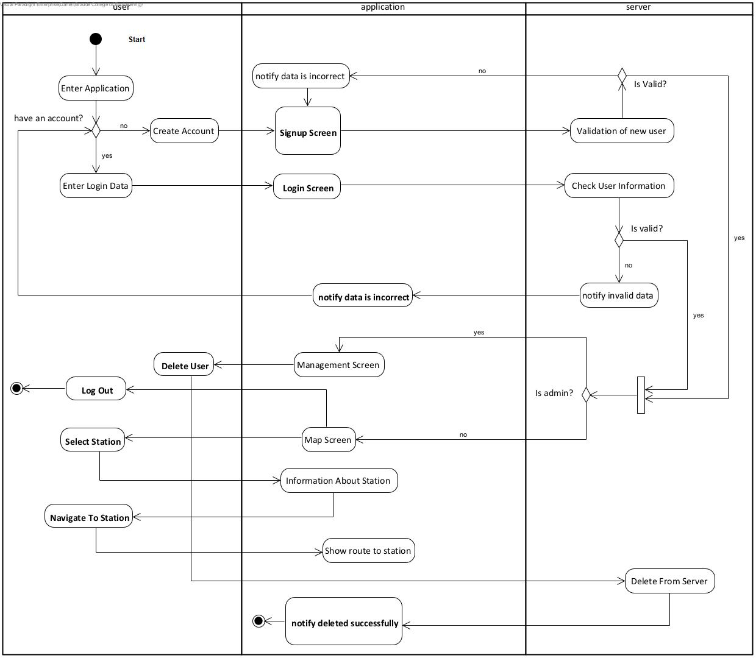
Activity Diagram

Slide 15
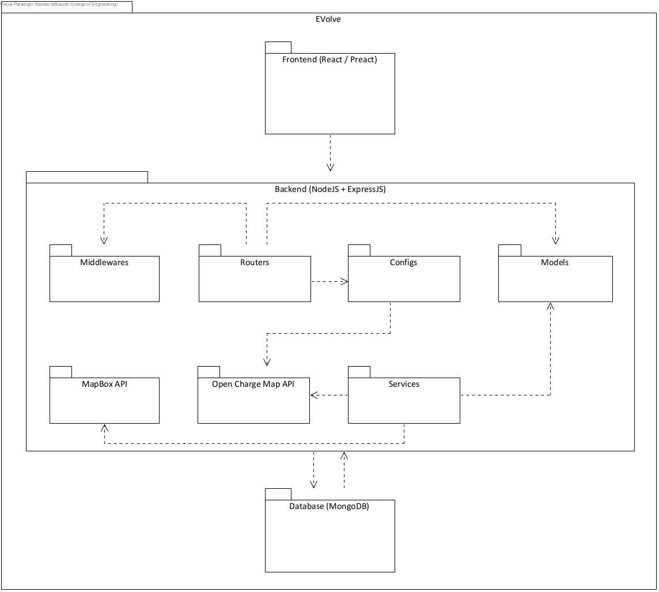
Package Diagram

Slide 16
04
Verification plan
With performance and functionality testing

Slide 17
Verification plan
Our tests were designed to ensure the reliability of our application both on the client side and the server side.
We conducted two primary forms of evaluation: functional testing and performance testing.
The performance testing was conducted using a built-in tool in the Chrome browser called Lighthouse that allows users to measure and analyze the performance of the application using different metrics.

Slide 18
Functional Tests
No. | Test Subject | Expected Result | Result
1 | User enters an email in the wrong format and press submit. | Pop up with an error message. | Pass
2 | User tries to login with the wrong user name. | Alert message “wrong username or password” appears. | Pass
3 | User tries to login with the wrong password. | Alert message “wrong username or password” appears. | Pass
4 | User tries to register as Admin with the wrong secret key. | Alert message “Invalid Admin” appears | Pass
5 | User tries to register with the wrong email format. | Pop up with an error message. | Pass

Slide 19
Functional Tests
6 | An already registered user tries to register using the same email address. | Alert message “Something went wrong” appears. | Pass
7 | New user fills all the sign up forms correctly and presses the “sign up” button. | Alert message “Registration successful” appears. | Pass
8 | User enters his email and password correctly and press submit. | Application moves to a “map screen” and presents the closest stations to the user's location. | Pass
9 | User clicks on a station icon. | A floating window with information about the station appears. | Pass
10 | User clicks the “Get Direction” button in the station window. | Navigation to the station from the user's current location starts. | Pass

Slide 20
Functional Tests
11 | Admin enters his username and password and presses “submit”. | Application moves to a “manage screen” and presents a table with all registered users information. | Pass
12 | Admin clicks on “delete” in the user's information row. | Alert message “are you sure you want to delete this user” appears. | Pass
13 | Admin clicks the “approve” button when he asks if he is sure he wants to delete a user. | Alert message “deleted” appears and table updates. | Pass
14 | Admin clicks the “Logout” button in the management screen. | Application moves back to the main sign in page. | Pass
15 | User clicks the “Logout” button in the map screen. | Application moves back to the main sign in page. | Pass

Slide 21
Performance Tests
We measured 4 web performance metrics:
First Contentful Paint (FCP)
Measures the time from user navigation to the display of any page content.
Optimal Goal: Achieve FCP of 1.8 seconds or faster.
Time to First Byte (TTFB)
Gauges the duration from resource request to the arrival of the first byte of the response.
Optimal Goal: Target TTFB of 0.8 seconds or less.

Slide 22
Performance Tests
Cumulative Layout Shift (CLS)
Measures layout shift scores resulting from unforeseen shifts throughout the page lifespan.
Optimal Goal: Achieve CLS score of 0.1 or lower.
Largest Contentful Paint (LCP)
Indicates the time it takes for the largest image or text block within the viewport to be rendered.
Optimal Goal: Achieve LCP of 2.5 seconds or faster.

Slide 23
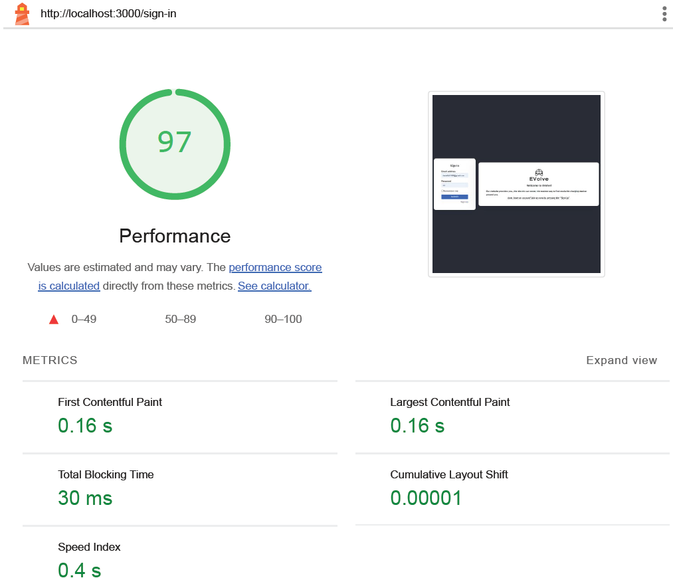
Performance Tests

Slide 24
Performance Tests
 | React + Bootstrap | Preact + Tailwind
 | Login / Register page
FCP TTFB CLS LCP | 259.6 ms 4.8 ms 0.01 ms 271.3 ms | 162.9 ms 2.6 ms 0.01 ms 162.9 ms
 | Admin control panel page
FCP TTFB CLS LCP | 623.7 ms 317.3 ms 0.03 ms 706.1 ms | 216.8 ms 7.09 ms 0.03 ms 275.7 ms
 | Map page
FCP TTFB CLS LCP | 199.09 ms 8.9 ms 0.02 ms 204.7 ms | 180.02 ms 5.4 ms 0.02 ms 190.5 ms

Slide 25
05
Demonstration In action

Slide 26

Demonstration

Slide 27
06
Challenges & Conclusions Implementation challenges and conclusions

Slide 28
Challenges
Google Maps API: We faced difficulties in integrating the API into our web application.
MongoDB Database: We encountered difficulties in setting up the database, establishing connections, and managing data efficiently.
Choosing the First Frameworks to Develop: Selecting the initial frameworks to develop our web application was a crucial decision

Slide 29
Conclusion
Based on our evaluation and analysis, we concluded that the Preact and Tailwind combination performed better than the React and Bootstrap combination in terms of performance, size, and user experience. Preact and Tailwind offered a faster, lighter, and more responsive web application, while maintaining the same functionality and features as React and Bootstrap. Therefore, we recommend Preact and Tailwind as the best fit framework for web application development, especially for projects where performance and efficiency are paramount.

Slide 30
THANKS!
Do you have any questions?

